Slide 1
SI 206: Discussion 6
Working with Files and Midterm Review

Slide 2
As it says in the syllabus:
“You earn points for attempting [discussion] assignments; they do not have to be correct.”
This also means that you don’t have to complete the entire assignment – get as far as you can, and then hand in whatever you have – you’ll get full points just for having worked on it!

Slide 3
Midterm Review

Slide 4
Functions, Conditionals
Functions
Defined with the keyword def
Must be called to execute
Conditionals
Execute code if a Boolean expression is true or false
if-elif-else
Logical operators (and, or, not)

Slide 5
Strings and Lists
Strings
String methods (str.lower(), str.upper(), str.capitalize(), etc)
String indexing and slicing
Lists
Holds items in order
List methods (append, extend, pop, reverse, sort, etc)
List indexing and slicing

Slide 6
Loops, Tuples, and Dictionaries
Loops
For loop
For each item in a collection
For value in range
While loop
While some Boolean expression is true
Tuples
Immutable
Tuple indexing
Dictionaries
Key:value pairs
Dictionary methods – keys(), values(), items(), get(), etc.

Slide 7
Turtles
Turtle methods
forward(), backward(), color(), goto(), left(), right(), pendown(), penup(), pensize(), setheading(), etc.
Screen methods
screensize(), bgcolor(), exitonclick(), etc.

Slide 8
Terminal, Git, and GitHub
Terminal commands
cd – change directory
pwd/chdir – print current directory
ls/dir – list contents of directory
Git commands
git clone - make a copy of your remote repo on your local computer
git add – add file to your staging area
git commit – record changes in your local repo
git push – send your committed local changes to a remote repo (GitHub)
git status – where you can see what is staged for a commit, what has changed but not staged, and what is ignored

Slide 9
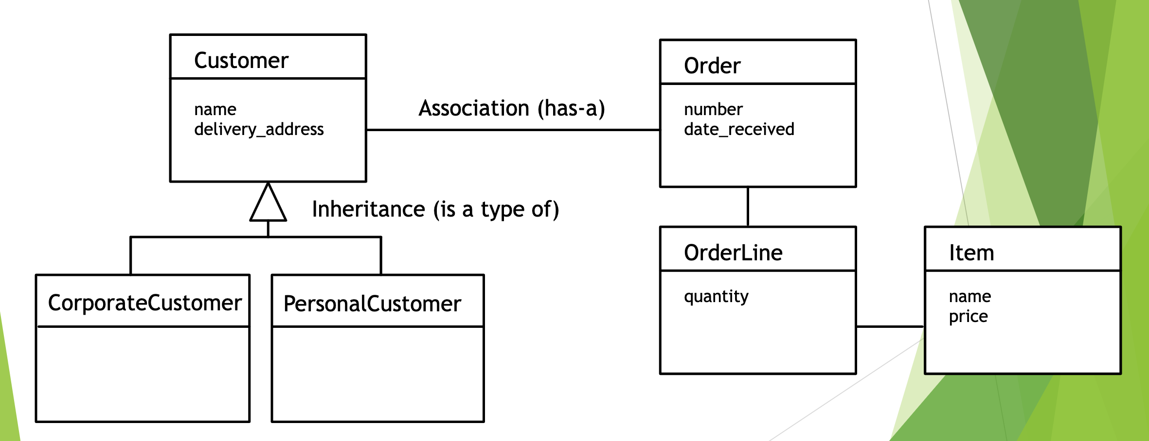
Classes and Objects
Class: defines what all objects of the class know (attributes) and can do (methods)
Object: an instance of a class
Inheritance: one class can inherit from another
Association: one class can be associated with another

Slide 10
Unit Tests
Import unittest
Make a subclass of unittest.TestCase
Define methods for test cases
Start each method with test_
Use assertion methods – ex: assertEqual() – to check the results
Run the tests using unittest.main
Test cases
Test usual values
Test edge cases

Slide 11
Discussion 6 Exercise

Slide 12
CSV Format
CSV (comma separated values) files are a simple and lightweight way to store structured data. They can be read by many different programs and are a common format for sharing datasets.
A CSV file represents data as a series of rows and columns, much like an Excel spreadsheet or a matrix.
The first row of a CSV usually contains the name of each column. This is called the header row. Most CSVs have one, but it isn’t required.
Each line of a CSV represents a row. Usually the columns are separated from each other using commas (,) within each row, unless specified otherwise.
Other separators such as tabs (\t) and pipes (|) can be used, but commas are by far the most common.

Slide 13
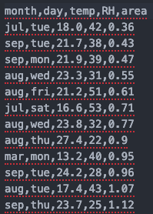
Example CSV data
Header
(Note that the columns are only separated with commas. There is no need for additional spaces between commas.)

Slide 14
Newline Characters (\n)
When we open a CSV file in a program like Excel or an IDE like VSCode, the rows are automatically placed onto their own line for readability.
However, since computers don’t have eyes, they need to use a special character called a newline to know where one line should end and one should begin.
A newline character is represented in Python as ‘\n’ and it counts as a single character, i.e., len(‘\n’) == 1 would return True)
You won’t need to worry about this for today’s assignment, but (hint hint) it may be useful for upcoming assignments

Slide 15
Sorted
Recall that the built-in function sorted() can be used to sort a list alphabetically (A → Z) or in ascending numerical order. Passing reverse=True reverses this behavior. Remember that sorted does not modify an existing list. It returns a copy of the list that has been sorted.
name_list = ["Yoshi Kano", "Jackie Cohen", "Paul Resnick", "Sam Carton"]
reverse_sorted_names = sorted(name_list, reverse=True)
print reverse_sorted_names
['Yoshi Kano', 'Sam Carton', 'Paul Resnick', 'Jackie Cohen']

Slide 16
Passing a lambda function to the key parameter allows us to sort a dictionary by its values. (Default is to sort by keys)
fruits_list = {"apple" : 3, "grape" : 1, "melon" : 2}
sort = sorted(fruits_list.items(), key = lambda x: x[1], reverse = True)
OR
def sortval(x):
return x[1]
sort = sorted(fruits_list.items(), key = sortval)
print(sort)
[('grape', 1), ('melon', 2), ('apple', 3)]

Slide 17
Today’s Assignment
We will be working with a dataset of Forest Fires
The adapted dataset contains the following columns:
month - month of the year: 'jan' to 'dec'
day - day of the week: 'mon' to 'sun'
temp - temperature in Celsius degrees: 2.2 to 33.30
RH - relative humidity in %: 15 to 96
area - the burned area of the forest (in hectares): 0.09 to 1090.84

Slide 18
Your Task
In the starter code you are given a class, FireReader and several methods to implement
FireReader reads in the CSV file and builds a dictionary where each key is the name of a column, and each value is a list of the data in that column. The dictionary is stored in an instance variable called data_dict
self.data_dict = {
‘month’: [‘jul’, ‘sep’, ‘sep’...],
‘day’: [‘tue’, ‘tue’, ‘mon’...],
‘temp’: [18.0, 21.7, 21.9…],
‘RH’: [42, 38, 39…],
‘area’: [0.36, 0.43, 0.47...]
}
becomes

Slide 19
Your Task
First, you’ll need to fix the bugs in the build_data_dict() method
HINT: Think about the header row and how columns are separated in CSVs
Then you’ll need to implement each method of the FireReader class according to the instructions in the starter code.
We have provided several test cases for you that should pass if you’ve completed the assignment successfully; please don’t change any of these test cases

